Slide 1
Computing Values of Symmetric Square L-Functions using Ichino’s Pullback Formula
Samuel Pease
Senior Thesis at Duke University
Advised By Dr. Aaron Pollack

Slide 2
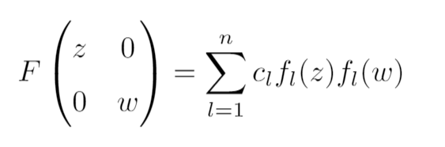
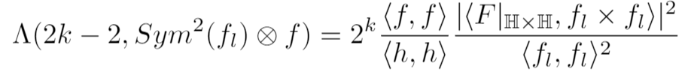

Two Main formulas
Where

Slide 3
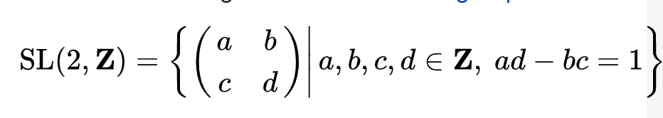
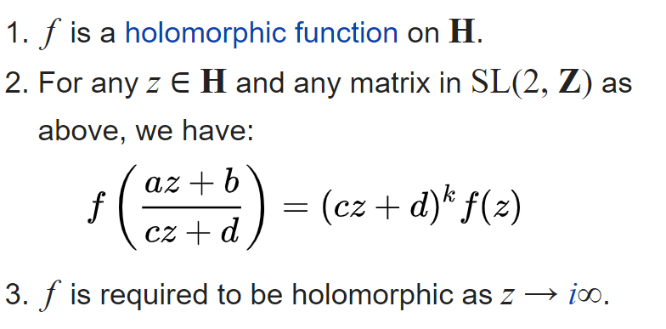
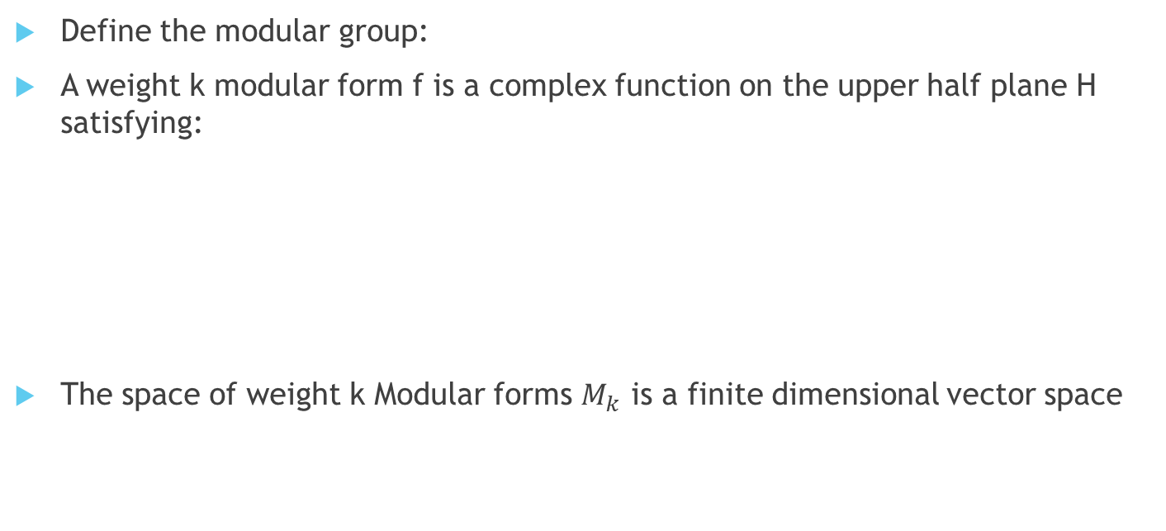
Modular Forms
Define the modular group:
A weight k modular form f is a complex function on the upper half plane H satisfying:
The space of weight k Modular forms $M_{k}$ is a finite dimensional vector space

Slide 4

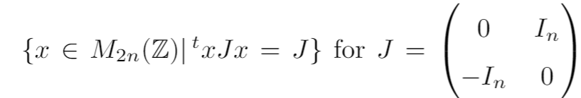
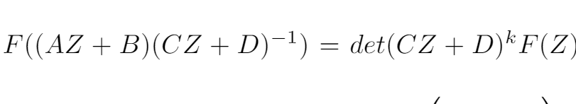
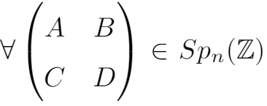


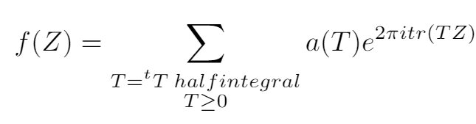
Siegel Modular forms
Define the Siegel Upper half-space:
The symplectic Group:
Then a complex function, F, on the Siegel upper half space is a Siegel modular form if it is holomorphic and
Has Fourier Expansion as the matrix gives relation

Slide 5
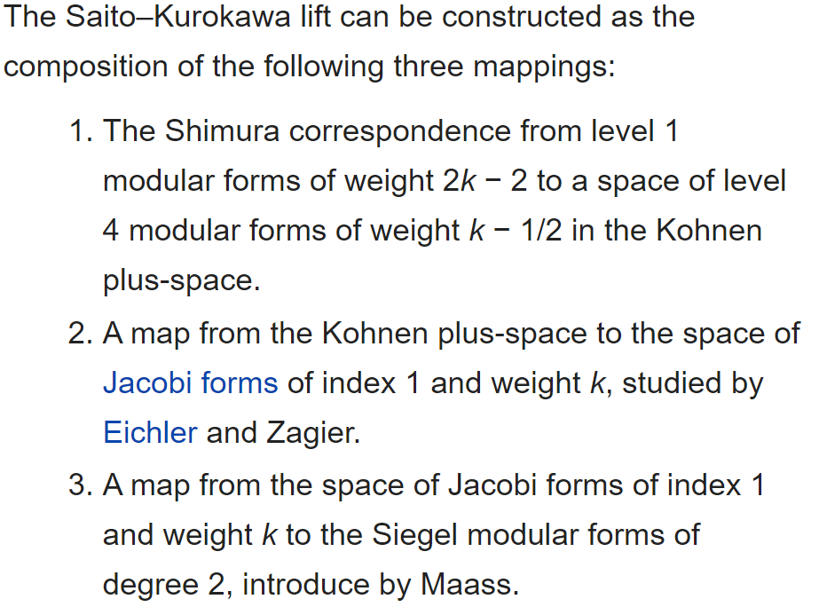
Saito-Kurokawa Lift

Slide 6

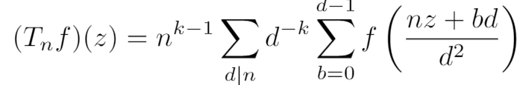




Hecke Operators
Linear operator Defined as
Or can write Fourier expansion
Where
Petersson inner product:
Under this inner product the Hecke operators are self adjoint. Because of this and fact that these operators commute we can find a basis that consists of modular forms that are simultaneous eigenvectors of all Hecke operators. This is called an eigenform basis. A given eigenform is normalized if a(1) = 1 in its Fourier expansion.

Slide 7
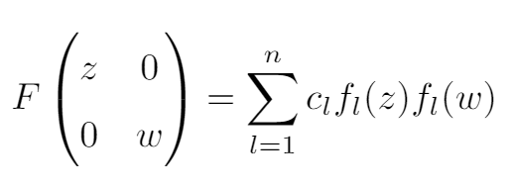
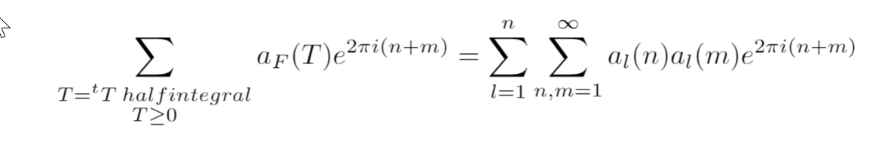
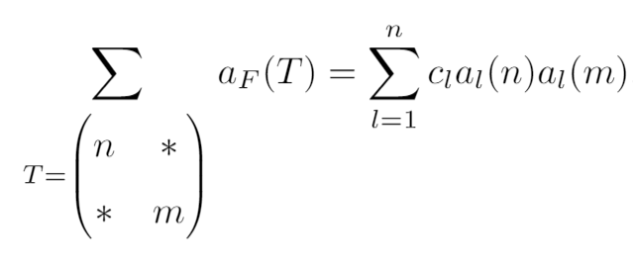
Pullback Formula
From the pullback formula:
We can compute the following relation between terms in the fourier coefficients of the functions F and f_l.

Slide 8
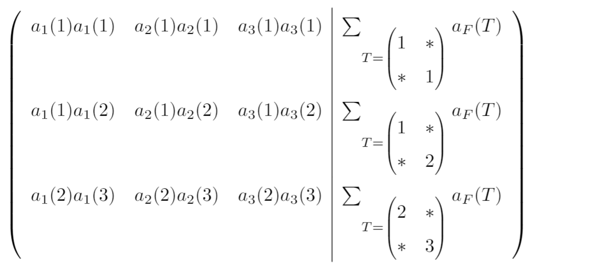
Code I wrote
Imported data from LMFDB.org
Construct matrix:
Solve

Slide 9
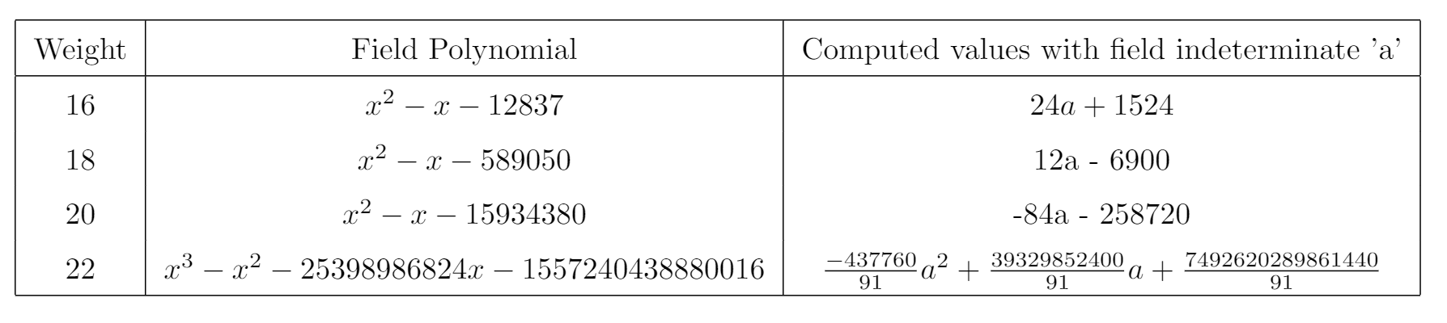
Results

Slide 10
Conclusion
Found values of
Next steps would be to get more computational power to find higher weights.

